Slide 1
Optical Character Recognition
-

Slide 2
Team Members
Jinal Kothari : 16BCP021
Nihit Parikh : 16BCP027
Krina Savaliya : 16BCP045
Rajvi Abhangi : 16BCP071

Slide 3
Introduction
Optical character recognition, as the name suggests is all about recognizing characters from the given image, document etc.
It can recognise all the alphabets(a-z) and numbers(0-9).
Formally, it can be defined as: “Optical character recognition or Optical character reader, often abbreviated as OCR, is the conversion of images of typed, handwritten or printed text into machine-encoded text.”
It can be from a scanned document, a photo of a document, a scene-photo or from subtitle text superimposed on an image.

Slide 4
Scope
Data entry for business documents, e.g. check, passport, invoice, bank statement and receipt
Automatic number plate recognition
In airports, for passport recognition and information extraction
Extracting business card information into a contact list
More quickly make textual versions of printed documents, e.g. book scanning
Make electronic images of printed documents searchable, e.g. Google Books
Assistive technology for blind and visually impaired users

Slide 5
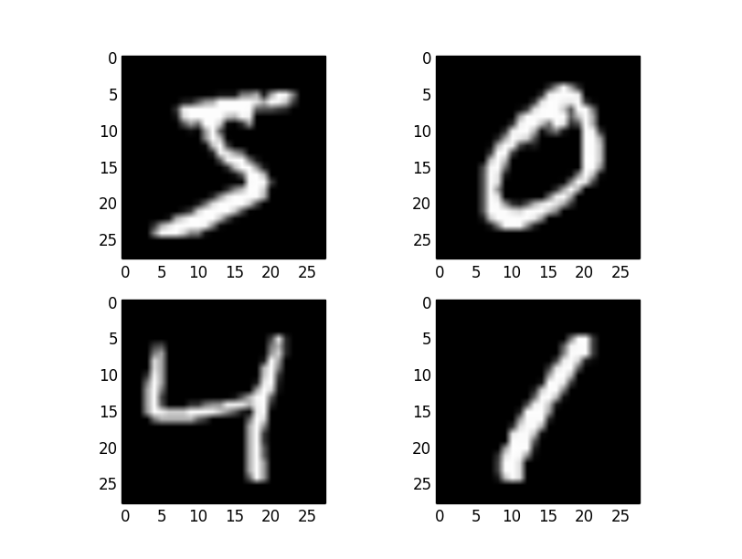
Digit Recognition
X1,…,Xn ∈ {0,1} (Black vs. White pixels)
Y ∈ {0,1,2,3,...,9} (predict the digit depicted in the picture)

Slide 6
Dataset
Source: https://github.com/kipr/opencv/tree/master/samples/python2/data
The Data set contains digits (0-9)
The images are 20 x 20 pixel black and white images
There are total 500 image samples for each digit, where each sample represents a different way of writing the digit.

Slide 7
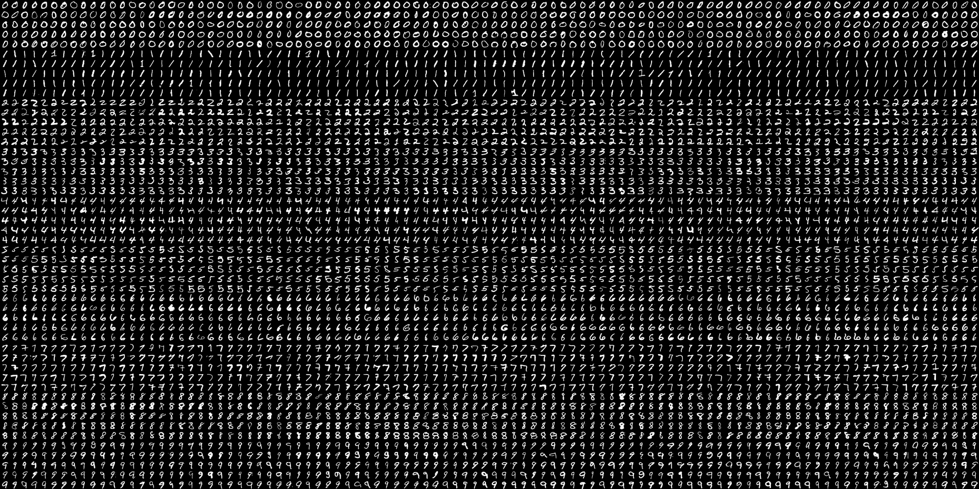

Slide 8
Data Pre-processing
As our dataset was already pre-processed, there is not much pre-processing required.
Image Segmentation: we stripped the overall dataset into individual images of 20 x 20 pixels.
During the training phase:
The background was converted from Black to white
The part of the image that contains digit was converted from White to Black
Now this image in intermediate phase, is finally converted to grayscale image for training the dataset.

Slide 9
Training
During the training phase:
The background was converted from Black to white
The part of the image that contains digit was converted from White to Black
Now this image in intermediate phase, is finally converted to grayscale image for training the dataset.
K-fold Cross Validation
Approach: K-nearest Neighbor Algorithm

Slide 10
Testing
First the testing image sample is converted to grayscale image.
Using Thresholding function, the grayscale image is converted to B&W image.
Using K-nearest Neighbor Algorithm, the testing image’s distance is calculated in trained model and nearest digit is assigned to the test image.

Slide 11
Initial Results
Training : 50% & Testing : 50%
K = 3, Accuracy: 91.64%
K = 4, Accuracy: 91.92%
K = 5, Accuracy: 91.75%
K = 6, Accuracy: 91.56%
Reversed training & testing for the above case:
K = 3, Accuracy: 92.16%
K = 4, Accuracy: 92.2%
K = 5, Accuracy: 91.96%
K = 6, Accuracy: 92.12%

Slide 12
Initial Results
Training : 80% & Testing : 20%
K = 3, Accuracy: 93.10%
K = 4, Accuracy: 94.00%
K = 5, Accuracy: 93.09%
K = 6, Accuracy: 93.20%

Slide 13








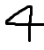
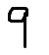
Testing on images
0
1
2
3
4
3
3
1
8
1

Slide 14
License Plate Recognition
License Plate Recognition Systems uses the concept of optical character recognition to read the characters on a vehicle license plate.
LPR takes the image of a vehicle as the input and outputs the characters written on its license plate.

Slide 15
License Plate Recognition Approach
License Plate Recognition has 3 major steps:
License Plate Detection
Character Segmentation
Character Recognition

Slide 16
Tesseract – Google OCR
Tesseract is an OCR engine with support for unicode and the ability to recognize more than 100 languages
Tesseract4 has two OCR engines- legacy Tesseract engine and LSTM engine
All network layer types are derived from the Network base-class. The Plumbing sub-class is a base-class for layers that manipulate other layers in some way, e.g. by reshaping their input/output or organising a group of layers.

Slide 17
Adding a new Layer Type
A new layer class must derive from Network or Plumbing and implement at least the following virtual methods:
Forward to run the layer in the forwards direction.
Backward to run the layer in the backwards direction during training.
Layers that have weights must also implement Update to update the weights with a set of gradients

Slide 18
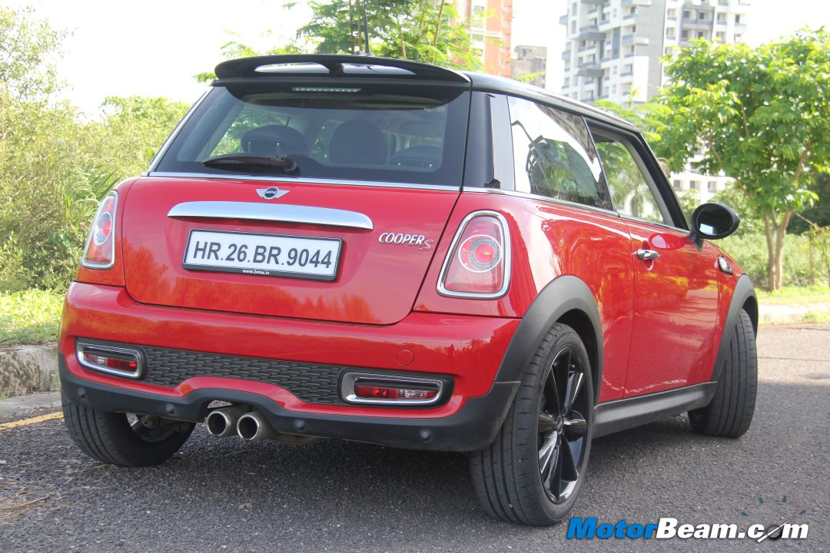

Approach
License Plate Detection
INPUT
OUTPUT

Slide 19
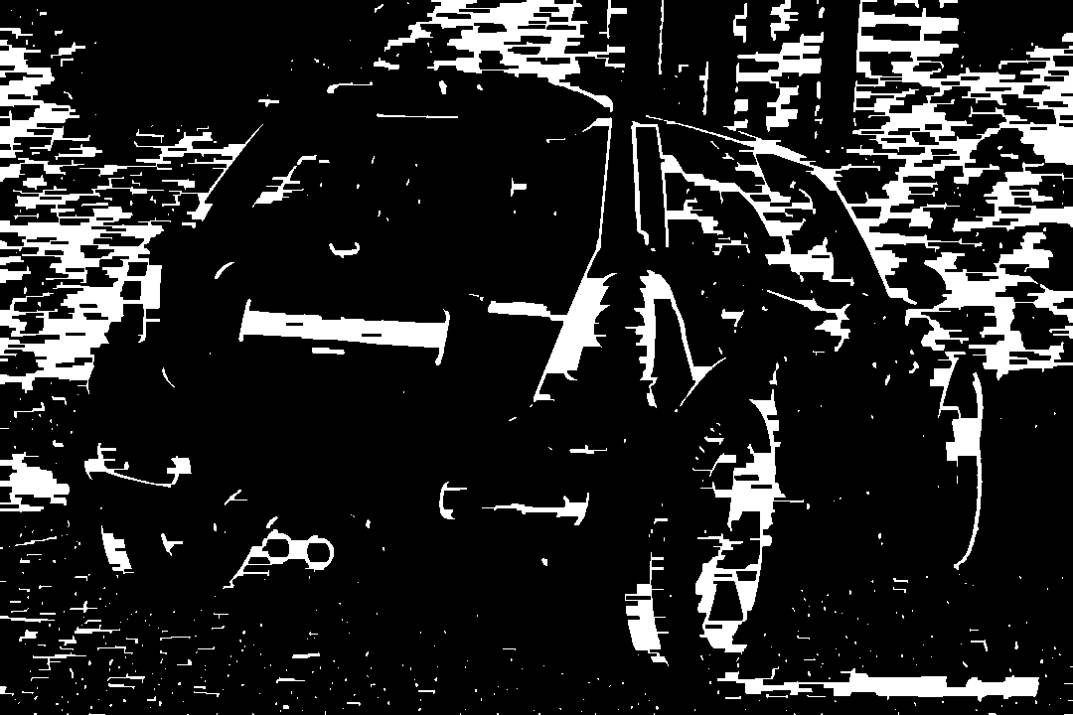
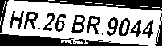
Approach
Morphed Image
Morphing is an image processing technique used for the metamorphosis from one image to another. The idea is to get a sequence of intermediate images which when put together with the original images would represent the change from one image to the other.

Slide 20
Approach
Characters are segmented and recognized using built in libraries which might consists of Deep Neural Networks for high accuracy

Slide 21
Testing
OUTPUT-
HR.26 BR 9044
INPUT

Slide 22
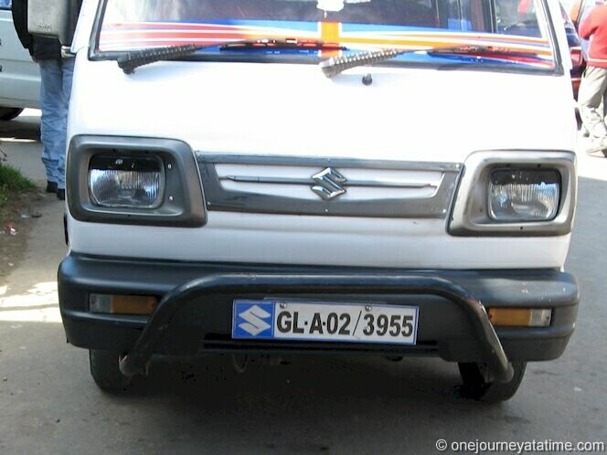
Testing
OUTPUT-
GL-A02/3985
INPUT

Slide 23
Conclusion
OCR
An accuracy of 94% was noted for digit recognition using OCR (Training and testing set where from same database).
An accuracy of 60% was noted when images where given as input to OCR.
License Plate Recognition
Most of the characters are recognized properly and some characters are not recognized properly.

Slide 24
References
https://github.com/kipr/opencv/tree/master/samples/python2/data
https://dzone.com/articles/prerequisites-for-building-an-ocr-scanner-from-scr
https://en.wikipedia.org/wiki/Optical_character_recognition#Techniques

Slide 25
THANK YOU!

